Slide 1

DELE CA1 • COMPUTER VISION
Handwritten
Letter Recognition
DELE CA1 Part A: CNN
YAN MYOE NAING
HANDWRITTEN LETTER RECOGNITION / 01

Slide 2
02 • DELE CA1 PART A
Task and Data
26
28×28
784
99,040
letters A–Z
grayscale image
pixels / sample
raw rows
Each row contains one label column plus 784 pixel columns. The goal is a 26-class classifier for handwritten capital letters.
LABEL + PIXELS
HANDWRITTEN LETTER RECOGNITION / 02

Slide 3
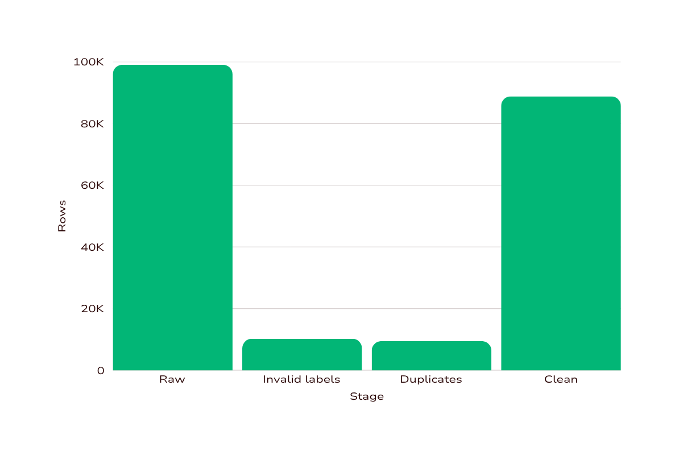
03 • DELE CA1 PART A
Data Inspection
10,240
invalid-label rows (−1 / −2), mostly blank or noisy
9,465 duplicates
Checked, but not all removed. One corrupted invalid row reaches pixel value 345.
CLEAN 88,800
Keep labels 1–26 and pixels 0–255; do not subtract the corrupted row twice.
HANDWRITTEN LETTER RECOGNITION / 03

Slide 4
04 • DELE CA1 PART A
EDA and Preprocessing
01 Reshape → 28×28
3,365–3,453
02 Transpose → upright
samples per letter before cleaning
03 Normalise ÷ 255
Fairly balanced classes. Stroke width and letter shape vary naturally. Transpose is a fixed orientation correction—not augmentation.
04 Add channel → 28×28×1
05 Map labels → 0–25
HANDWRITTEN LETTER RECOGNITION / 04

Slide 5
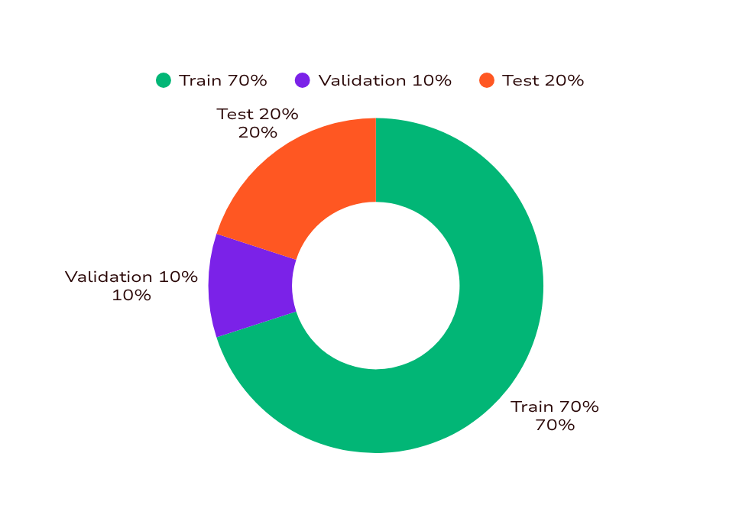
05 • DELE CA1 PART A
Stratified Split
62,160
TRAIN / learning
8,880
VALIDATION / model selection
17,760
TEST / final evaluation
STRATIFIED • SEED 88
HANDWRITTEN LETTER RECOGNITION / 05

Slide 6
06 • DELE CA1 PART A
Baseline CNN Architecture
Conv 30
5×5 + ReLU
MaxPool
2×2
Conv 15
3×3 + ReLU
MaxPool
2×2
Dropout
0.20
Flatten
Dense 501
ReLU
Dense 26
softmax
92.97%
0.2119
validation accuracy
validation loss
206,273 parameters • Adam • sparse categorical crossentropy • 5 epochs
MAIN CONFUSIONS I / L G / Q U / V
HANDWRITTEN LETTER RECOGNITION / 06

Slide 7
07 • DELE CA1 PART A
Improvement Experiments
MODEL 1
MODEL 2
Filters 32/64 · 3×3 kernels
Stronger dropout · Dense 512
Leaky ReLU
Batch-size adjustment
MODEL 3
MODEL 4
Batch Normalisation
Stronger regularisation
Leaky ReLU + Batch Normalisation
Compared as combinations; results do not establish causal certainty for any one change.
HANDWRITTEN LETTER RECOGNITION / 07

Slide 8
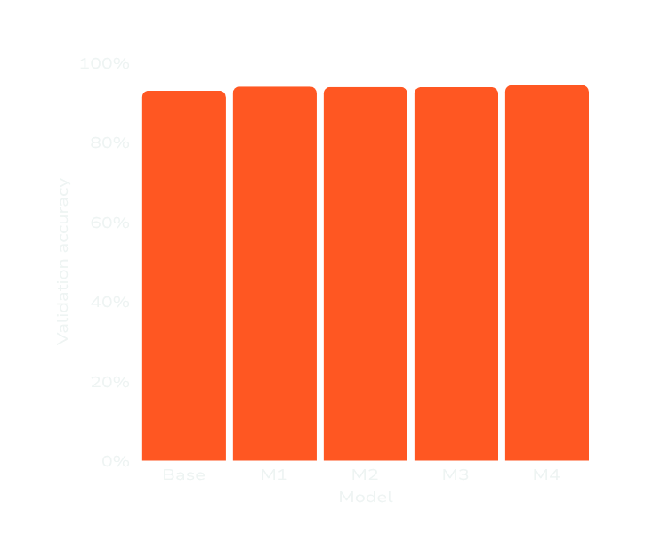
08 • DELE CA1 PART A
Model Comparison
MODEL
VALIDATION ACCURACY
LOSS
Baseline
92.97%
0.2119
Model 1
93.98%
0.2064
Model 2
93.89%
0.2156
Model 3
93.85%
0.2170
Model 4
94.34%
0.1889
MODEL 4 • BEST OF THE INITIAL FOUR • SMALL BUT PRESENT GAIN
HANDWRITTEN LETTER RECOGNITION / 08

Slide 9
09 • DELE CA1 PART A
Static Augmentation Results
Mild random rotation ±0.05
translation ±0.08 · zoom ±0.08
Applied only to training images
94.13%
94.34%
WITH AUGMENTATION
loss 0.1948
MODEL 4 BASELINE
loss 0.1889
NO IMPROVEMENT
Adds data and training cost; static augmentation was not selected.
HANDWRITTEN LETTER RECOGNITION / 09

Slide 10
10 • DELE CA1 PART A
Selected Architecture and Dropout
Conv 32
BN · LeakyReLU
MaxPool
2×2
Conv 64
BN · LeakyReLU
MaxPool
2×2
Dropout
0.35
Dense 384
BN · LeakyReLU
Dropout
0.40
Dense 26
softmax
94.43%
0.1798
tuned validation accuracy
validation loss
FINAL MODEL
rebuilt + retrained
Adam + sparse categorical crossentropy
EarlyStopping: val_loss, patience 3, restore best weights
Max 30 epochs · batch size 200
HANDWRITTEN LETTER RECOGNITION / 10

Slide 11
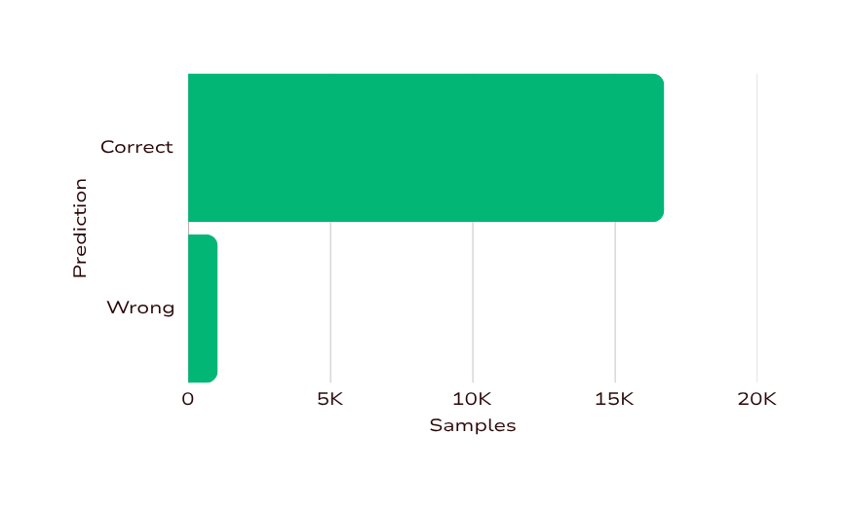
11 • DELE CA1 PART A
Final Test Results
94.16%
5.84%
0.1763
ERROR RATE
TEST LOSS
TEST ACCURACY
17,760 total samples
16,723 correct • 1,037 wrong
Macro precision 0.9423
Macro recall 0.9416
F1-score 0.9418
Weighted F1 0.9418
Validation and test metrics are kept separate.
HANDWRITTEN LETTER RECOGNITION / 11

Slide 12
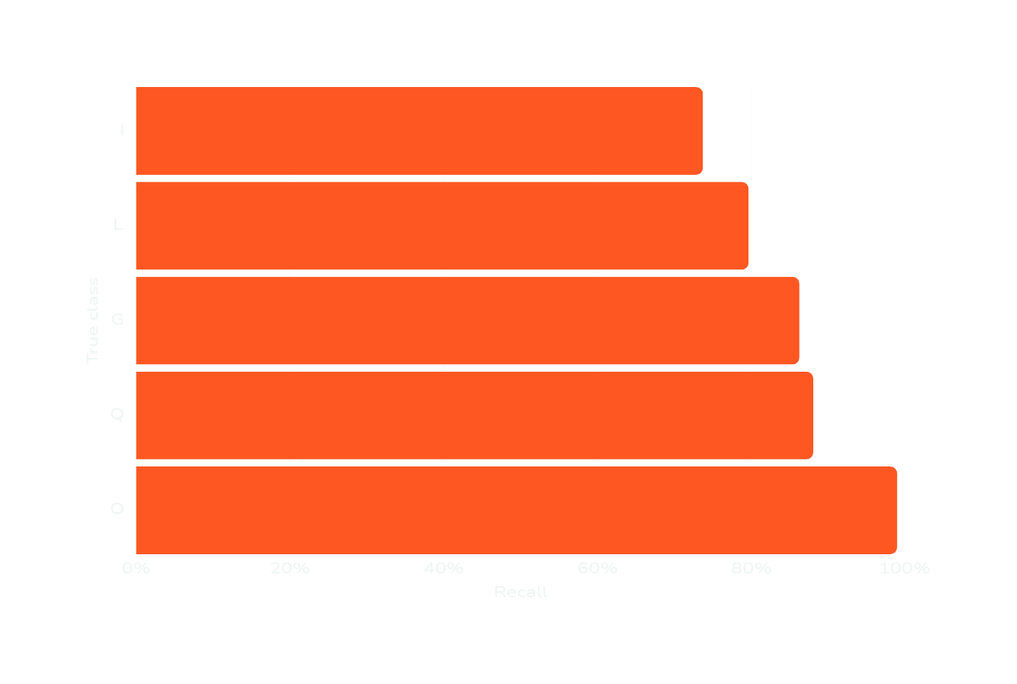
12 • DELE CA1 PART A
Class Performance
I 73.72%
L 79.65%
weakest recall
O 98.97%
strong example
“Class accuracy” in the notebook means recall within the true class—not global accuracy. Similar handwritten shapes are hardest.
HANDWRITTEN LETTER RECOGNITION / 12

Slide 13
13 • DELE CA1 PART A
Actual Confused Pairs
TRUE → PREDICTED
I
L
L
I
G
Q
167
132
66
Q
G
U
V
V
U
60
32
21
Vertical-stroke I/L is notably weaker; rounded G/Q is the next major difficulty. No claim of balanced performance.
HANDWRITTEN LETTER RECOGNITION / 13

Slide 14

14 • DELE CA1 PART A
Conclusion and Save
94.16%
FINAL TEST ACCURACY
• 5.84% errors, often between similar letters
• Static augmentation not selected
• Rebuilt + reloaded: same 94.16% / 0.1763
• Fixed seed still allows run-to-run variation
• Future: improve similar-shape discrimination
THANK YOU
CA1_PartA_final_model.weights.h5
YAN MYOE NAING
HANDWRITTEN LETTER RECOGNITION / 14

